Slide 1
Fundamentals of
Neural Networks
Talha Waheed

Slide 2
Connectionist Approach
Symbolic Versus Connectionist
Intelligence arises in systems of simple interacting components (neurons) through a process of learning by which the connections between components are adjusted.

Slide 3
Characteristics
Processing is distributed and parallel
Not explicitly programmed
No explicit manipulation of symbols.
Patterns are encoded as numerical vectors
Connection of components is also numerical
Transformation of pattern by numerical operations (Matrix multiplication)

Slide 4
Applications
Classification
Pattern Recognition
Memory Recall
Prediction
Optimization
Noise Filtering

Slide 5
Biological Neuron
SOMA – Cell Body (Main Processing Unit)
Dendrites – Input Units
  ~1,000-10,000
  ~ 1– 5 mm
Axon – Output Unit
  Usually 1 cm (1 meter in extreme cases)
Synapses – Connecting Junction
  excitatory and inhibitory
Electric Potential of Cell Body
Threshold of Neuron
Learning in brain – weight change and new connections

Slide 6
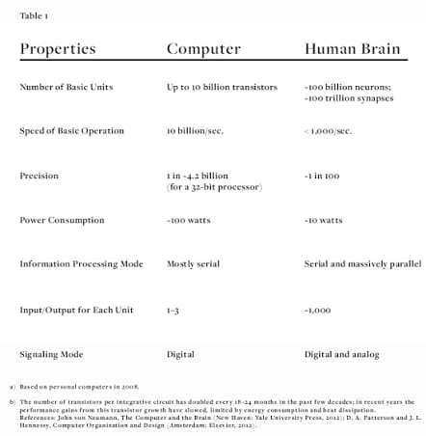
Computer Vs. Brain
Computational Units
  1 CPU, 10⁵ Gates vs. 10¹¹ neurons
Storage Units
  10⁹ bits RAM, 10¹⁰ bits disk, vs.
  10¹¹ neurons 10¹⁴ synapses
Cycle Time
  10⁻⁸ sec vs. 10⁻³ sec
Bandwidth
  10⁹ bits/sec vs. 10¹⁴ bits/sec
Neuron Updates/Sec
  10⁵ vs. 10¹⁴

Slide 7
Some Advantages of Neural Nets
Fault Tolerance
Graceful Degradation
Inductive Learning

Slide 8
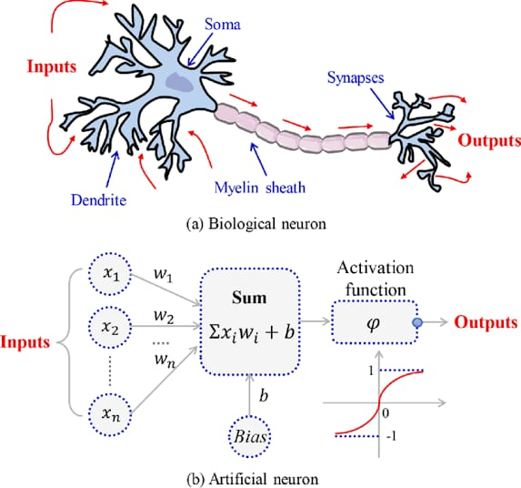
Artificial Neuron
X_{i} = Input Signals, discrete or real numbers
W_{i} = Set of real valued Weights
Σ W_{i}X_{i} = Activation Level
f = Threshold Function for output

Slide 9
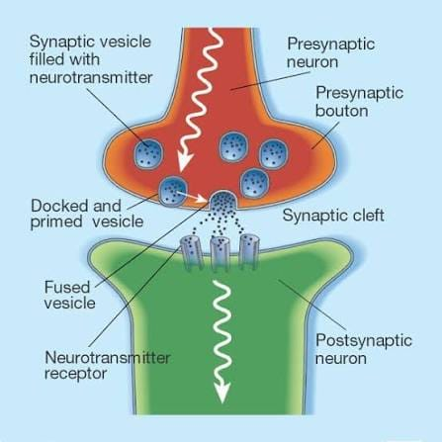
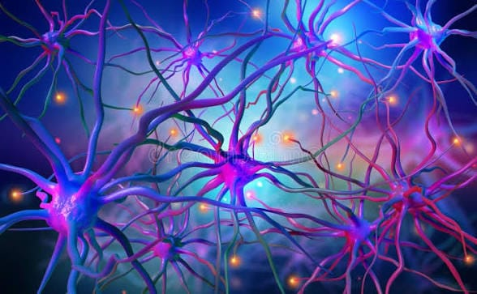

Slide 10
Artificial Neural Network
Network Topology
  feed-forward – unidirectional links
  Recurrent – any topology possible
Learning Algorithm
  to train the weights
Encoding Scheme
  Interpretation of input and output data
Universal approximator
Optimal Network Structure – Pruning, Tiling

Slide 11
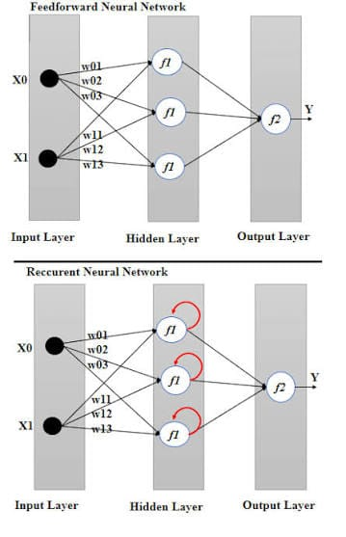
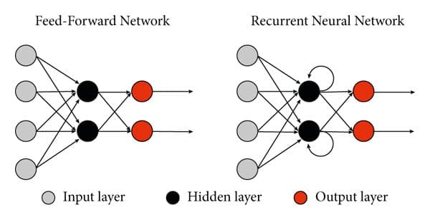

Slide 12
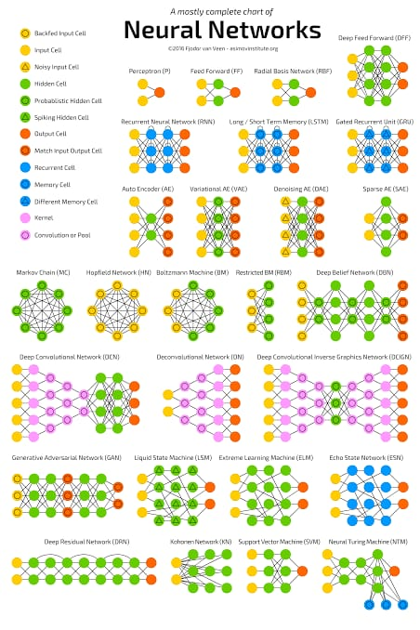

Slide 13
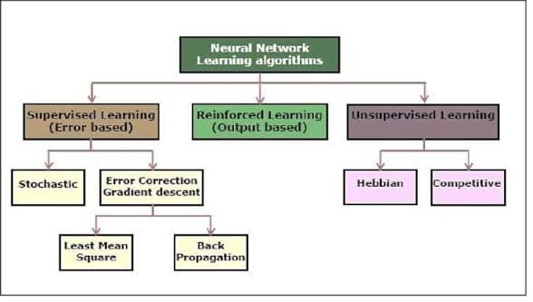

Slide 14
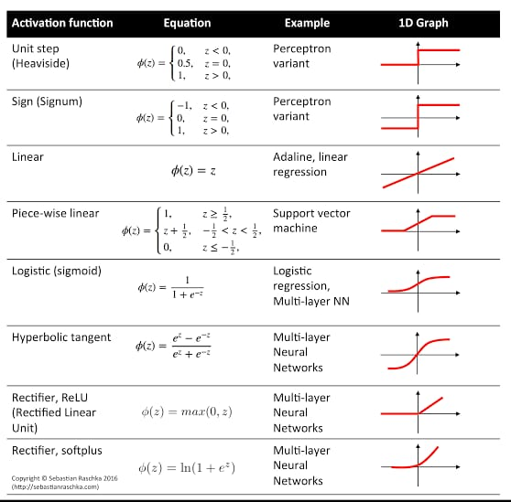

Slide 15
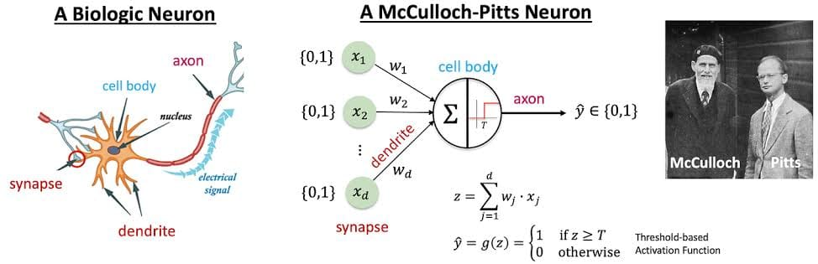
McCulloch-Pitts Neuron
McCulloch and Pitts (1943)
Inputs: Excitatory (+1) or Inhibitory (-1)
Weights: discrete numbers
Activation Function:
  if Σ W_{i}X_{i} >= 0
  Output = 1
  else
  Output = 0

Slide 16
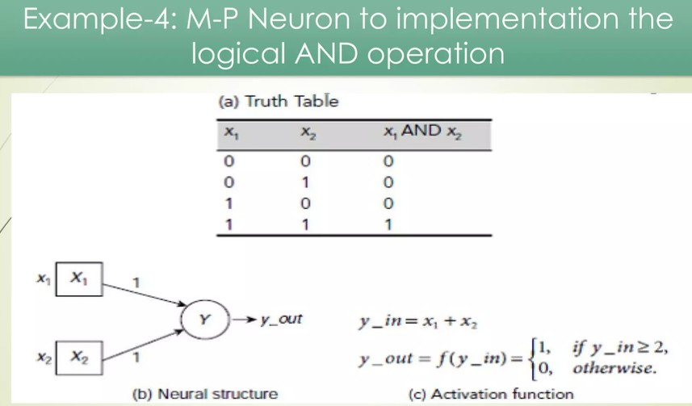
AND Function
Inputs: x, y
Weights: +1, +1
if (x * 1 + y * 1) >= 2
  return 1
  else
  return 0

Slide 17
OR Function
X Y Output
1 1 1
1 0 1
0 1 1
0 0 0

Slide 18
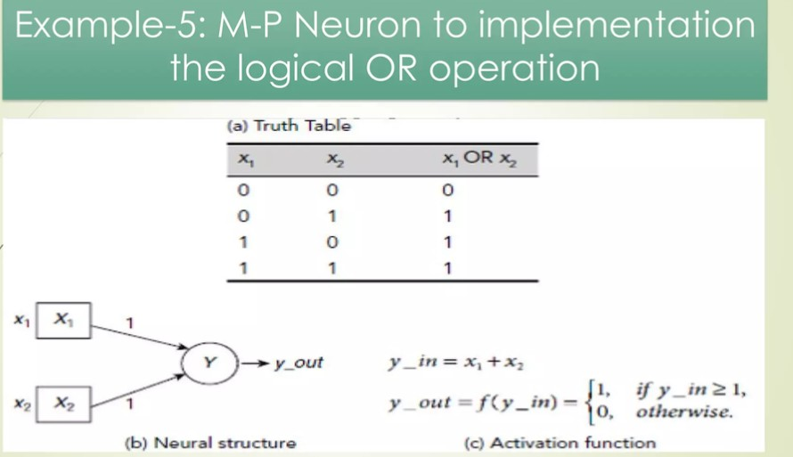
Or Function
Inputs: x, y
Weights: +1, +1
if (x * 1 + y * 1) >= 1
  return 1
  else
  return 0

Slide 19
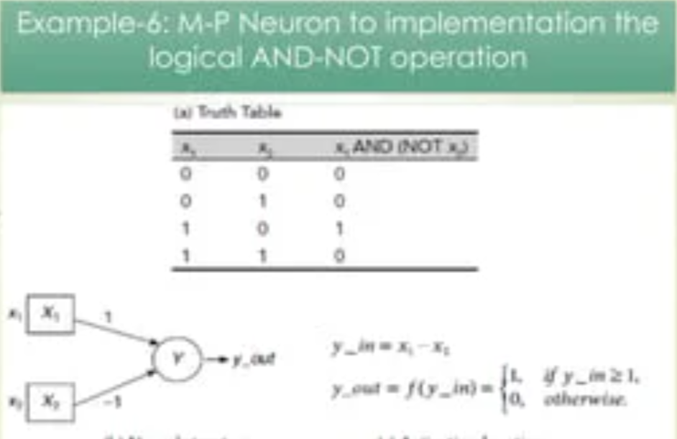

Slide 20
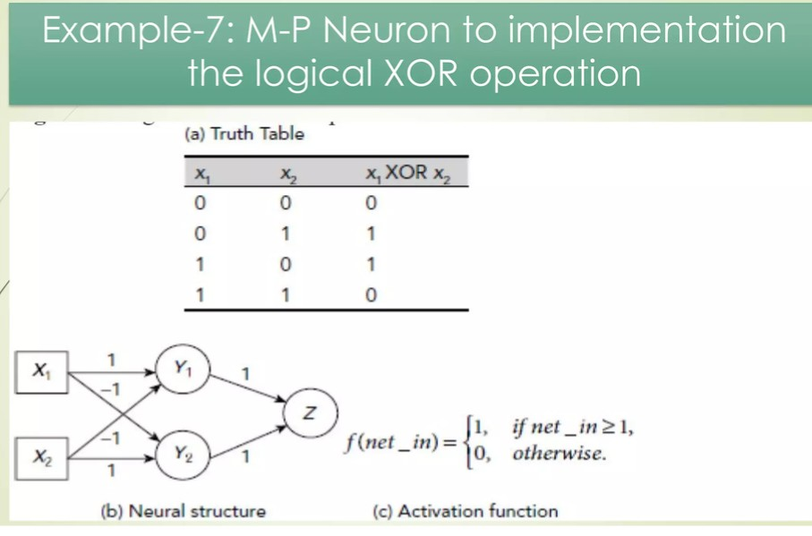

Slide 21
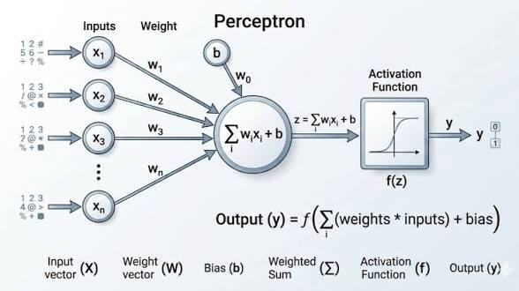
Perceptron
Frank RosenBlatt (1958)
Layer of Mc-Culloch Pitts Neuron
Input {–1, +1}
Output {-1, +1}
Weights {real values}
Activation Level Σ W_{i}X_{i}
Threshold Function
  +1 if Σ W_{i}X_{i} >= t
  -1 if Σ W_{i}X_{i <} t

Slide 22
Perceptron Learning
Supervised Learning
Δw = c (d – A) x_{i}
  C = constant
  D = desired output
  A = Actual Output, Sign (Σ W_{i}X_{i})
  X = Input
  Δw = w_{t+1} - w_{t}

Slide 23
Linear Separability
For a space of n dimensions a classification is linearly separable if its classes can be separated by an n-1 dimensional hyperplane
  In 2D an n-dimensional hyperplane is a line
  In 3D it is a plane

Slide 24
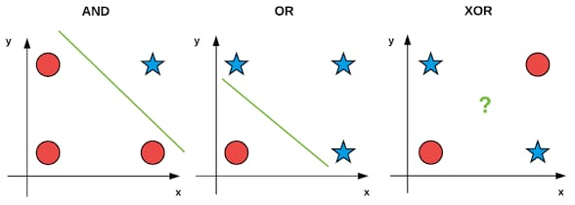
Perceptron Limitations
Nonlinear Separability (Minsky)
XOR Function
  w₁ * 1 + w₂ * 1 < t
  w₁ * 1 + 0 > t
  0 + w2 * 1 > t
  0 + 0 < t

Slide 25
Activation Functions
Unit Step (or Binary) Function
Bipolar Function (-1, +1)
Piecewise Linear Function
  Output is proportionally available in a range
Sigmoid Function
  Logistic Function is a type of sigmoid function
  f (Σ W_{i}X_{i} )=1/1+exp(-a* Σ W_{i}X_{i} )
  a = constant

